Slide 1
Class 8

Slide 2
Final exam

Slide 3
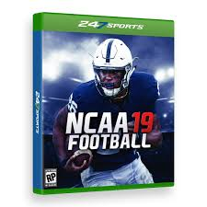
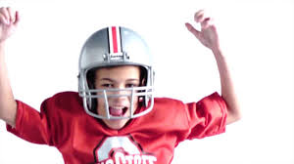
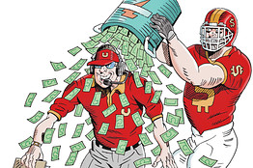
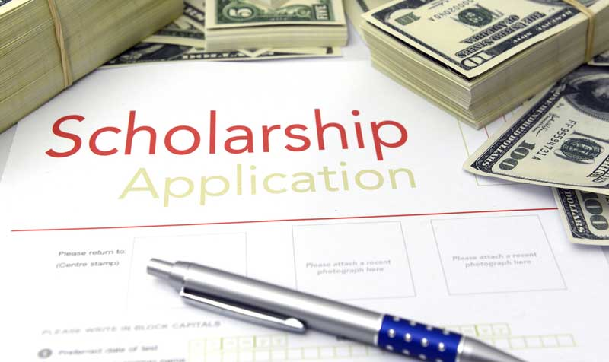
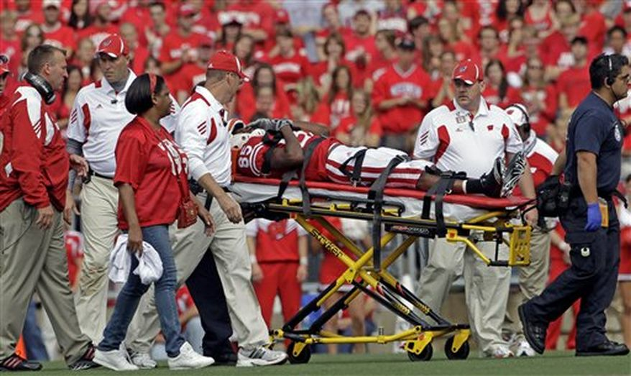
Last class

Slide 4

What is the problem?

Slide 5
Some other consequences

Slide 6
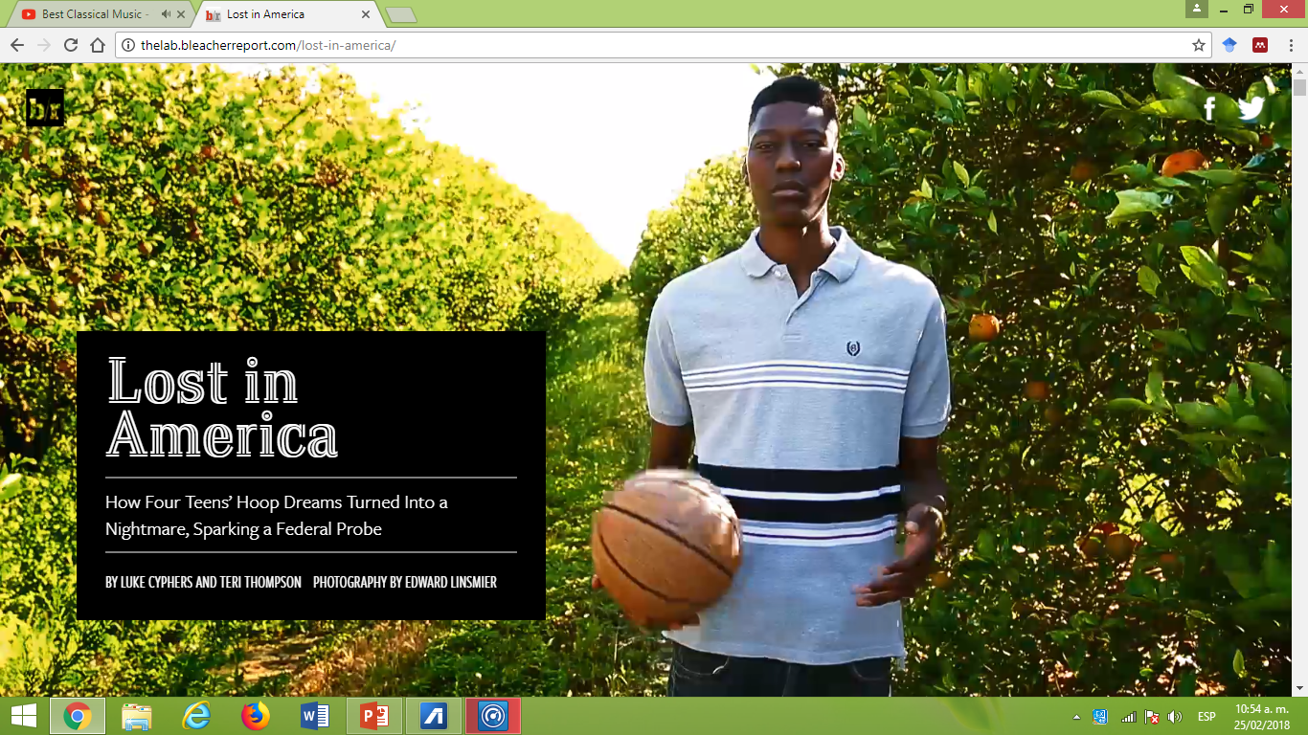
Some other consequences

Slide 7
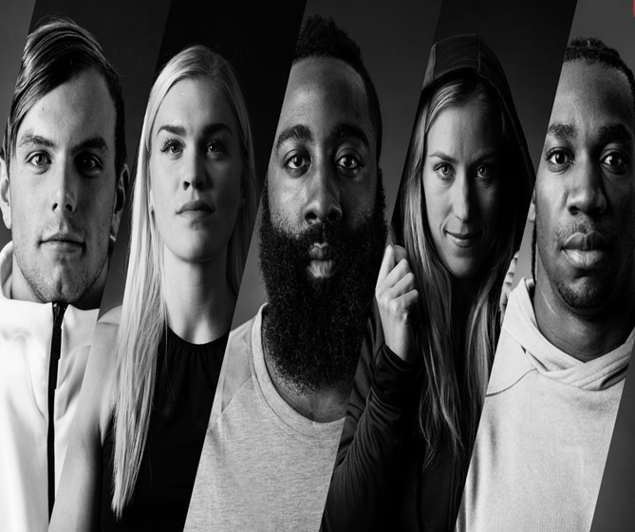
Sports and Social Mobility.
Are sports effective tools for social mobility?
Is becoming an athlete a realistic option as a career?
Are sports an effective tool for forging the necessary qualities –discipline, self-esteem, perseverance, etc. – to be successful in life?

Slide 8
We can see it in:
Public policy/organizations/international aid agencies.
People’s actions

Slide 9
According to some governments ( i.e. Sarkozy in France) and international organizations, YES!
The United Nation’s International Day of Sport for Development and Peace 6 April
"Sport is also an important enabler of sustainable development. We recognize the growing contribution of sport to the realization of development and peace in its promotion of tolerance and respect and the contributions it makes to the empowerment of women and of young people, individuals and communities as well as to health, education and social inclusion objectives."

Slide 10
If you don’t play sports, you are in a disadvantage!
http://www.thepostgame.com/hope-solo-us-youth-soccer-needs-be-affordable
The Guardian UK
“It’s only working for the white kids’: American soccer’s diversity problem
- Why is soccer not like basketball in the US?
What is the “pay-to-play” system?

Slide 11
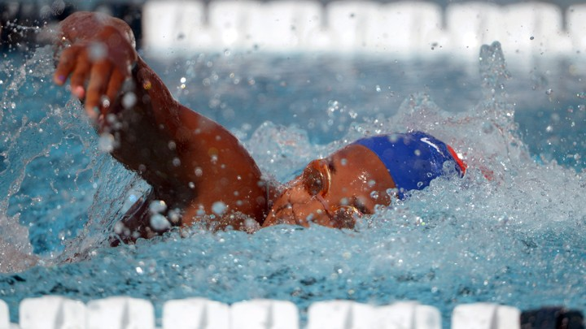
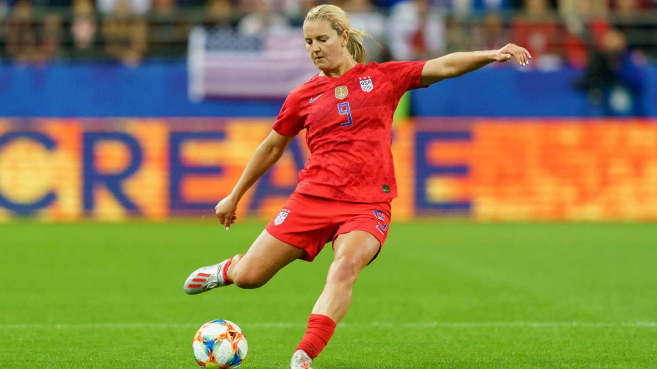
Swimming pools and soccer

Slide 12
Spaaji (2009)”Sports and Social Mobility”
Very critical view on the issue
The “myth” of social mobility through sports (statistically).

Slide 13
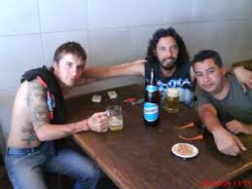
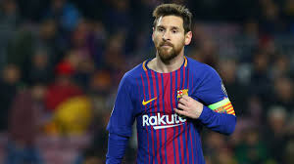
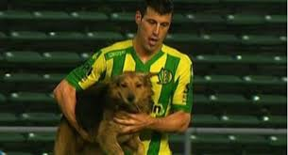
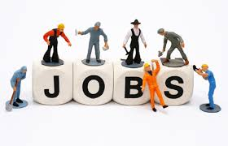

Spaaji 2009
Programs for promoting sports as tools for social change
To provide tools for social improvement
As an career option
Needs to be complemented with

Slide 14
Paradox
“While sport programs aimed at wider social objectives tend to be highly regarded by disadvantaged youth and their families, such programs tend to construct disadvantage young people as a social problem, and their ulterior political-ideological aim is to discipline and “civilize” the target group rather than enhance their agency and autonomy”

Slide 15

As a result:
Many of these programs promotes inequality by selling false promises to members of poor communities.

Slide 16
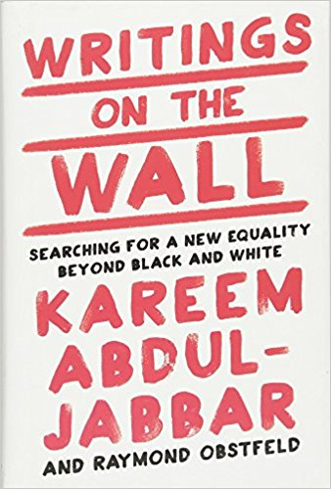
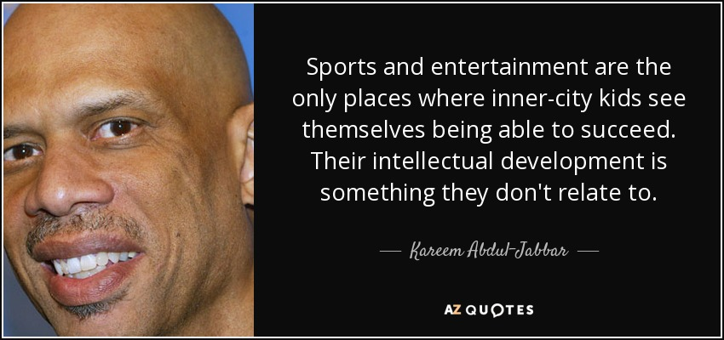
Kareem Abdul Jabbar

Slide 17
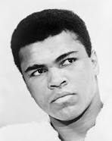
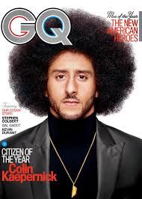
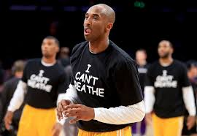
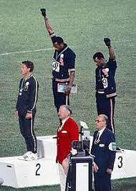
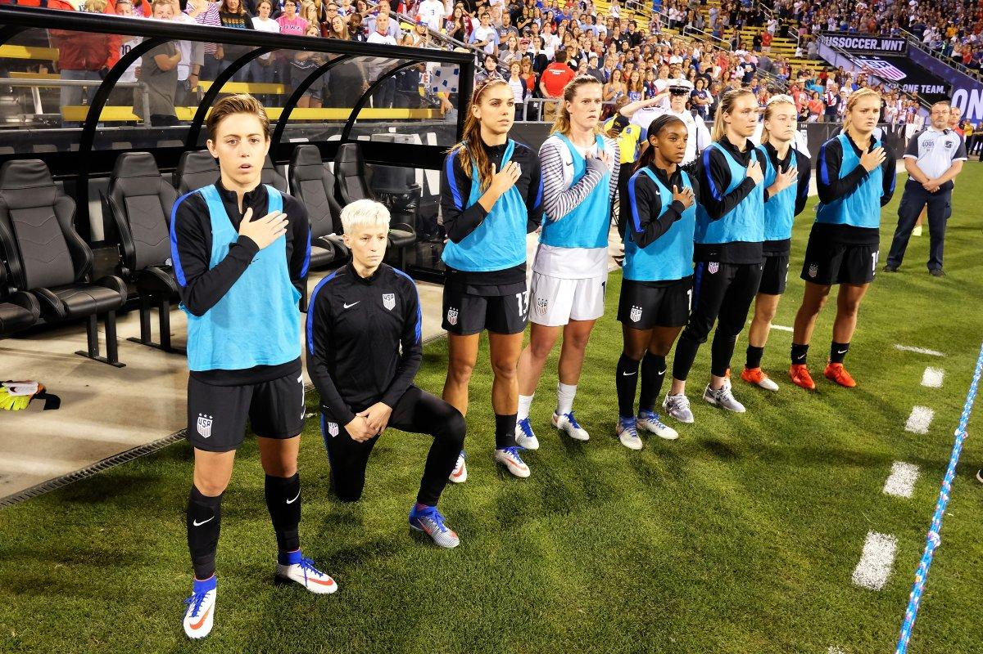
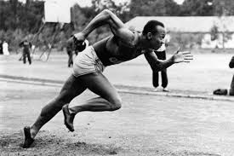
Sports and Social Mobilization

Slide 18
What is the contradiction related to the US National Anthem?
Do African American athletes reject the National Anthem?
Why were many Black Athletes involved in politics in the 1960s?
What did happen to the political “energy” in the 1980s-1990s.
What did change after 911 in relation to sports?
http://video.newyorker.com/watch/the-black-athlete-in-america

Slide 19
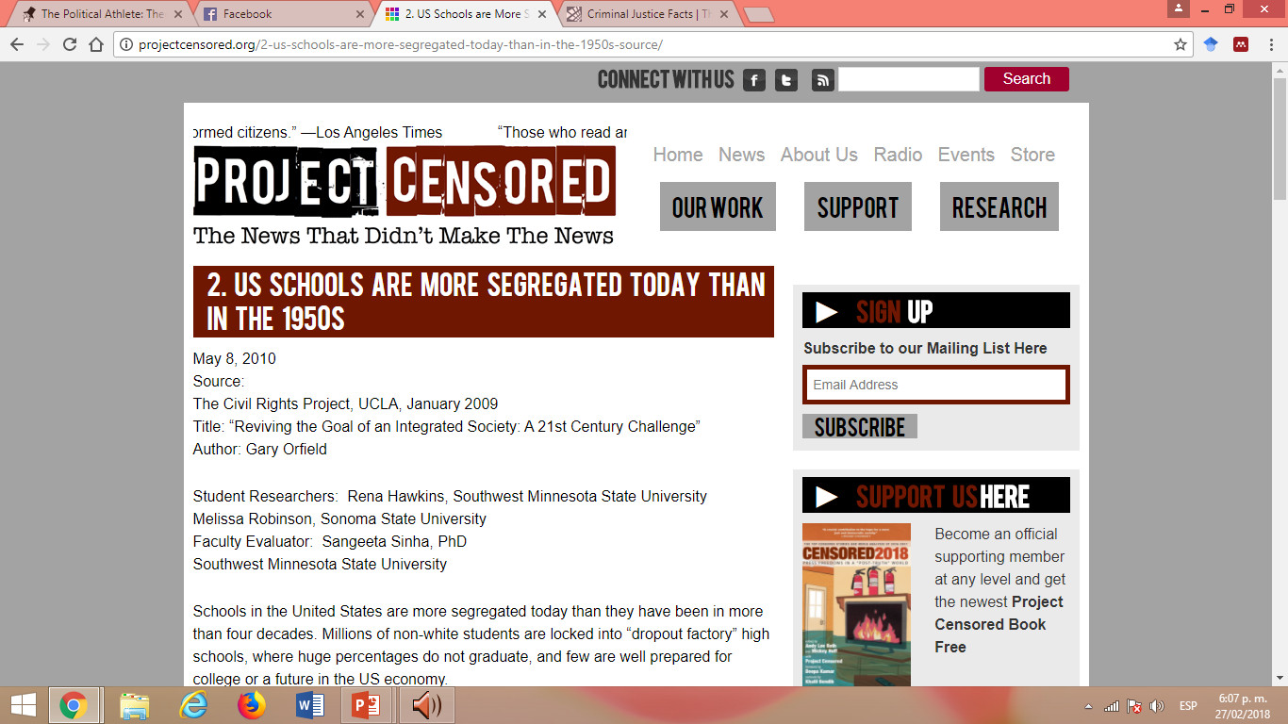
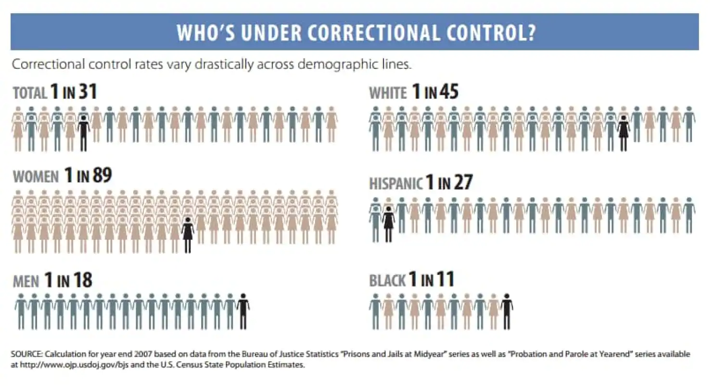
Why did athletes mobilized
1. Very bad conditions for their community.

Slide 20
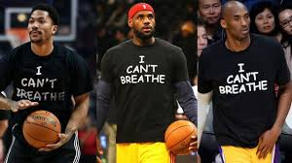
Why did athletes mobilized
2. But, for some the situation is getting better:

Slide 21
Lebron James

Slide 22
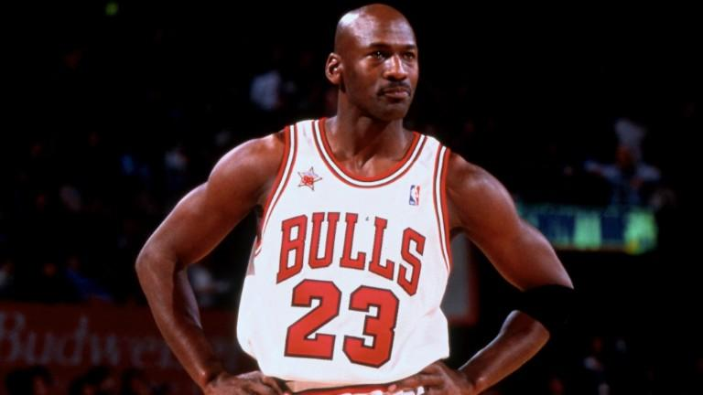
Michael Jordan

Slide 23
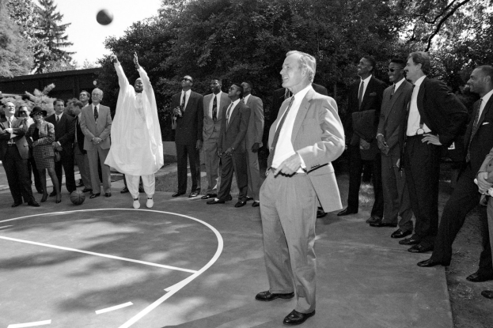
Craig Hodges: 'Jordan didn't speak out because he didn't know what to say‘ (The Guardian)
What did happen to his career?
Why didn't the Bulls renew his contract?
What was the difference between his case and Carlos and Smith back in the 1960s?
What were his beliefs on bombing Iraq?

Slide 24
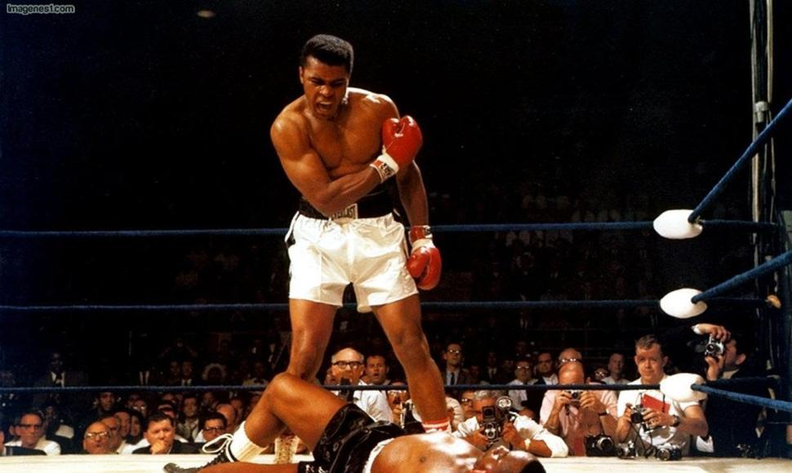
Mohammed Ali/ Refused to play the white game
Born in Kentucky in 1940s
Heavyweight Champion at very young age (22 years)
Very critical on “black integration”
Converted to Islam
Critical against the Vietnam war.
Conflicts with other black boxers
Fight in Zambia – Mubuto
Fought for money
supported Ronald Reagan.

Slide 25
Mohammed Ali/ Refused to play the “white game”
“With my gold medal actually hanging around my neck I couldn’t get a cheeseburger served to me in downtown Louisville restaurant”
To Patterson “ Come on, America! Come on, white America”.
“I ain’t got no quarrel with the Vietcong”
“I will die before I sell out my people for the white man money”.
https://www.youtube.com/watch?v=0k7Ir1bWjyM

Slide 27
Questions
Before Ali, what type of “role model” black athletes needed to be? (9)
What was the contradiction with that “role model” (9-10)
How did Mohammed Ali resolved the duality “Uncle Tom”/“Bad Ni66$%” (10)?
Why is the Mohammed Ali conversion as a political action (14)?
Why is the decline of black sports stars? (27-28)

